Slide 1
Parent Update Meeting - 15th March 2024

Slide 2
Welcome
How do Parent update meetings work?
Microphones should be on mute throughout the session.
Only questions submitted in advance will be answered.
Questions with a similar theme will be grouped together.
No recording of the presentation – notes will be taken and uploaded on to the school website.
Any questions arising from today's session should be emailed to Mrs Allport via PA@lsg.kevibham.org who will arrange for someone to contact you.

Slide 3
Uniform
There are no plans currently to review the uniform policy. This is because there was a full consultation in 2022.
The uniform policy at that point was relaxed slightly to allow for more items to be purchased from high street retailers. The cost of uniform was also considered and meets DfE guidance.
We have lots of student and parent voice opportunities and since the uniform was changed - we receive very little negative feedback about our uniform policy.
We are open throughout the Y6 admissions that we do have a tight uniform policy and therefore parents/students are aware of our expectations when they apply.
We believe that by ’sweating the small stuff’ and having a tight uniform policy, it contributes to the generally calm and well behaved environment in the school.

Slide 4
Assessment
We have three assessment points across the year. Two interim reports and one full report.
Most assessments will take place in normal lessons and might include classwork and homework.
The exception to this is the final assessment point which will be based on end of year exams.
To decide if KS3 students are meeting or exceeding expectations we will look at their KS2 results to see if they are making expected progress from their starting point - this means that one student might be ‘meeting’ expectations even with a lower mark their their friends who might be ‘exceeding’.
If we see that a student is constantly exceeding expectations in a subject, then we might review expectations to ensure that students are constantly challenged to be the best they can be.
In Y9 students will be allocated ‘target grades’ based on FFT and prior progress.

Slide 5
Homework
Homework is set on a weekly basis based on a recommended homework timetable that is published on the school website: https://lsg.kevibham.org/homework/
Homework is a mixture of online tasks, worksheets, revision, practical activities etc.
Not all homework will be marked by teachers, we will assess completion via a range of methods e.g. self assessment, peer assessment, low stakes assessments in class, exams.
Parents can see what homework has been set via their Class charts account. If you haven’t already been able to log on, please email the office who will be able to advise you how to access your account.
If students don’t have enough homework set/want to do extra, they are encouraged to read, go on GCSE pod, revisit work etc.

Slide 6
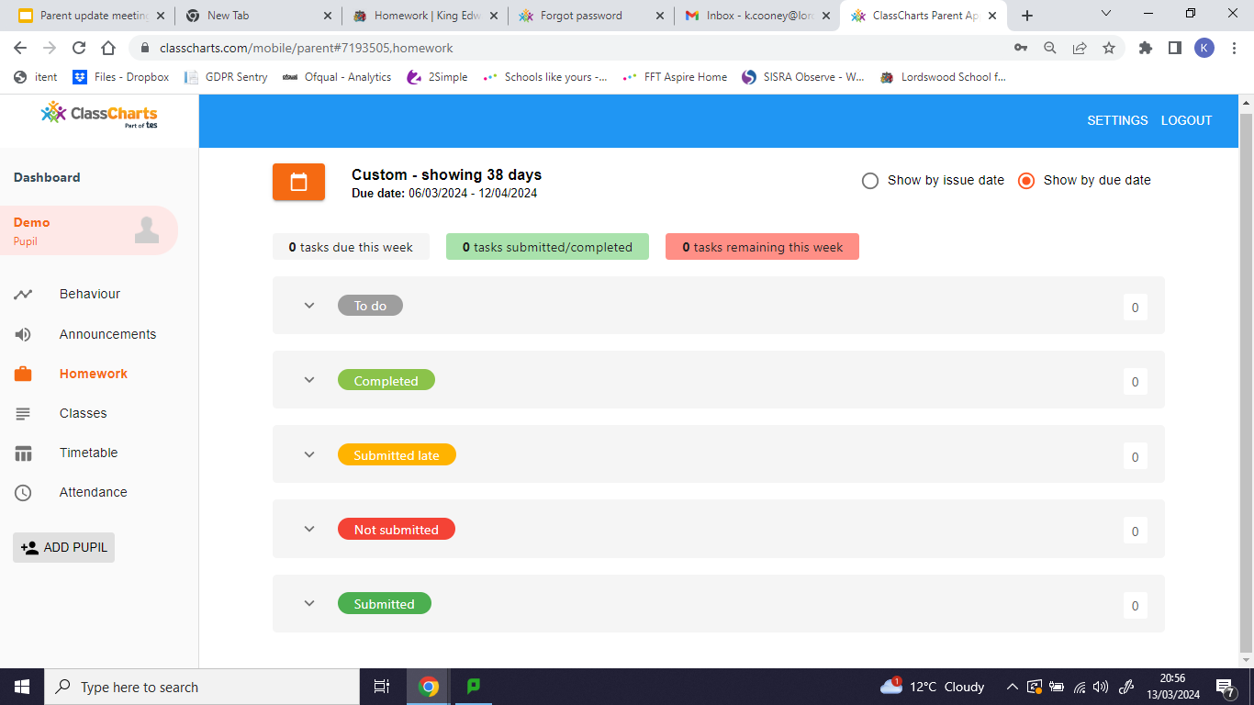
All homework set across the whole school can be seen via the following link: https://www.classcharts.com/homework/calendar/King-Edward-VI-Lordswood-School-for-Girls

Slide 7
Parents evenings
All year groups have 1 curriculum evening and 1 parents
evening each year
Y7 get an additional ‘settling in’ parents evening in the autumn term.
Except for the ‘settling in’ evening for Y7, parents evenings are all with subject teachers.
The time for parents evening appointments has always been 5min - being online makes no difference to this. I have worked in 7 different secondary schools and 5min is the standard amount of time per appointment.
If they were made longer then not everyone would be able to make an appointment (120min/5 = 24 appointments).
Appointments are available for all teachers (unless the teacher is ill) - sadly some teachers teach several classes in the same year group - appointments for these teachers will become fully booked first. We always ‘launch’ parents evenings appointments at a pre-advertised time so everyone has the same opportunity to book appointments. The later you book, the less appointments will be available.

Slide 8
Parents evenings
Following moving to online parents evenings during covid,
a staff and parent consultation was undertaken post covid to assess which method was preferred. 73% of the school community voted for parents evenings to remain online.
It was agreed that parent evenings would remain online. The advantages of online parents evenings include:
Flexibility to attend from work/home (avoiding the need to leave work early and find child care)
Fairer - in person parents evening often leads to queue jumping and some parents taking longer than their allocated time resulting in some people not seeing all the teachers they have booked to see).
Teachers can plan more effectively because they definitely know who they are seeing and in what order.
People not ‘over hearing’ information about other children
Less staff illness following parents evening (after live parents evenings, often see a spike in staff illness due to being in very close contact to so many people)
If teachers are absent you will receive an email informing you of their absence - offering a phone call upon their return.
If you experience technical difficulties - email office@lsg.kevibham.org and they will organise for teachers to be in contact with you.

Slide 9
Supply Teachers
Sadly due to the nature of teaching, teachers teach
(on average) 300 different students per week, teachers therefore get more illnesses than in other professions.
During the winter months this is always worse - this year there are several nasty colds and stomach bugs in circulation, along with an increase in COVID cases.
We have also had some longer term absences due to more serious medical conditions.
We do have 2 cover supervisors who we try to use where possible for short term illnesses and they deliver the powerpoints/work provided by the teacher.
Where we know that a member of staff will be off work for a longer period of time, we do look for subject specialists that can deliver the same content as their normal teacher would be covering.

Slide 10
GCSE Prep
Last year GCSE and A-levels returned to normal (the Covid adjustments were removed across the country)
As a school results in both GCSE and Alevel were higher than pre-covid results - indicating that any gaps created by covid had been closed. Our GCSE results put us in the top 100 schools in the country - showing our COVID catch-up strategy has been effective.
There are a range of interventions in place for Y11 and Y13 including - quality first teaching (including time for revision), revision guides, online learning platforms, intervention sessions, two mock sessions, alternative timetable once exams start.
If parents have question about how they can further support their child they should check out the curriculum pages on the school website or email office@lsg.kevibham.org indicating the subject that they would like to speak to.

Slide 11
Catering
Imagine having to cook for 1000 people every day - all with different pallets and preferences.
All external visitors to the school always comment on the service, taste and presentation of the food in school.
AIP are our catering company and we have the same menu as all other schools across the trust - however Nigel does try to adapt based on preferences of our students.
AIP/Nigel meets with our school council every term to listen to feedback and try to act on feedback where they can (there are lots of rules regarding food served in school)
I eat at the canteen every day and I am always the last person to eat so I can ensure that there is always food available. There is always a selection of food - otherwise I would be very grumpy!
We cannot invite parents to observe lunchtimes because of the capacity of the canteen and safeguarding.
If you have specific concerns regarding catering please email office@lsg.kevibham.org and someone will be in touch.

Slide 12
Friendship Issues
Working in a school with 920 females - there are going to be friendship issues.
We work with students to try and mediate where friendship issues arise.
In November the entire pastoral team attended ‘Girls on Board’ training to assist with resolving these issues.
If you want to support you daughter in navigating friendship issues, we recommend all parents read: When girls fall out by Andrew Hampton (https://www.girlsonboard.co.uk/parents/)
Social media is the main source of friendship issues in school - we cannot police what students do out of school. We recommend parents limit/monitor their daughters mobile phone usage.

Slide 13
Friendship Issues
Bullying is defined as ‘The repetitive, intentional hurting of one person or group by another person or group, where the relationship involves an imbalance of power.’
Luckily cases of bullying are rare.
Where we do identify bullying we do issue sanctions but we also work with families and students to find out why they are bullying and treat each case on an individual basis to try and prevent it happening again.

Slide 14
Enrichment opportunities
Teachers and support staff volunteer to run extra-curricular activities.
They do not get paid to run these activities.
We do have a wide range of activities each day. These can be found on the school website: https://lsg.kevibham.org/students/extra-curricular/
Therefore what we can offer is based on what staff are willing to provide
We are also reliant on staff having the skills to provide the clubs.
If students have ideas for extra-curricular activities, they can discuss with their teachers e.g. graphic design/coding/app - they might speak to their computing teacher to see if anyone has the skills to lead a club in this area.
Alternatively they can raise this with the school council rep - who can ask at their school council meeting.

